Slide 1
Multihopping in Wireless
IIIT Sri City
By
Dr. Hrishikesh Venkataraman

Slide 2
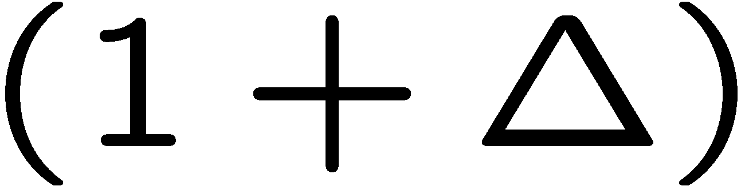
Resource Allocation - Spatial Reuse and Interference
The State-of-the-art protocols provide a heuristic solution for
solving an NP-hard problem (optimum resource allocation)
These state-of-the-art mechanisms do not utilize the resources
efficiently.
An efficient resource allocation mechanism needs to benefit
from spatial reuse of resource and must outweigh the
drawbacks of increased interference.
A circular exclusion region of radius times the
transmission distance, is defined around every
communicating receiver.
Typically, protocol Interference model with = 2.0

Slide 3
Interference Avoidance Model
2 pairs cannot communicate simultaneously
(only one of the pairs satisfy Protocol Model)
2 pairs can communicate simultaneously (both satisfy the Protocol Model)

Slide 4
General Multihop Network

Slide 5
No. of Concurrent Pairs
The transmission distance of every communicating pair is
different and it depends on the topology and network density
The number of simultaneous communicating pairs, n_{t}, for any
time instant, t, is a function of:
1. The distribution of mobile terminals,
2. The user density, and
3. The transmission distance’s and path losses of all concurrently
communicating pairs
Finding the maximum number of simultaneous pairs in a given coverage area is a very complex problem

Slide 6
General Scenario of Spatial Reuse
Notes:
Determining the maximum number of simultaneous communicating pairs (where each pair has a different transmission distance) is a Non-deterministic Polynomial-time (NP)-hard problem.
Also, there is no central-entity

Slide 7
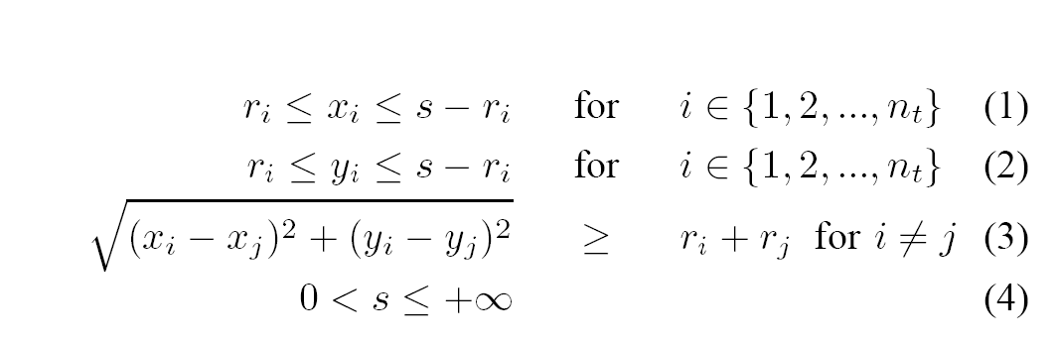
System Complexity
s is the side length of the coverage area,
x_{i} and y_{i} are the x and y-coordinate of the center of the exclusion range circle,
r_{i} is the radius of the exclusion range circle
Discrete optimization problem of NP-hard complexity

Slide 8
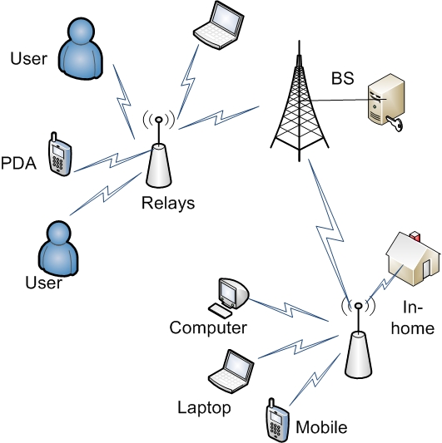
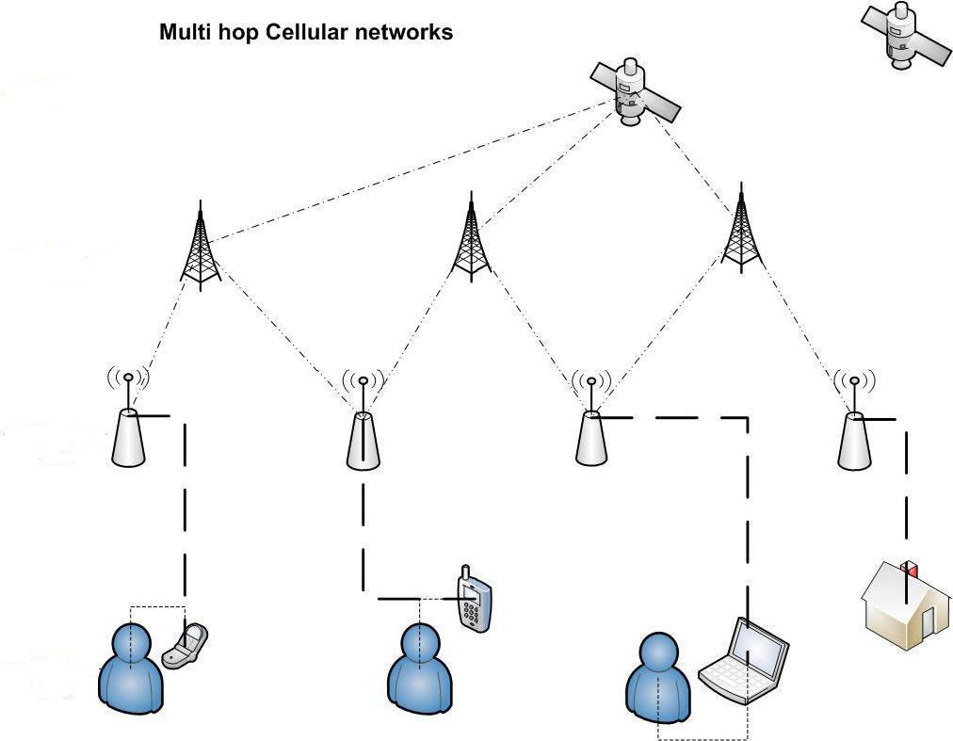
NEXT Generation Wireless Network

Slide 9
Single-hop TDMA System
TS i+2
TS i+1
TS i

Slide 10
General Multihop System
TSi = TSi₁ + TSi₂ + TSi₃
TS i₃
TS i₂
TS i₁
TS i
Notes:
The TSi is partitioned into 3 mini-slots. The single-hop link is split up into 3 hop link, such that, each of the multiple hops communicate over each of the mini TS.
It should be noted that, there is no spatial reuse of resources at this stage.

Slide 11
Spatial Reuse in Multihop
TS i₃
TS i₂
TS i₁

Slide 12
Power Requirement
P
Q
C₁ = log₂ (1 + 10^{(0.1γ1)}),
where γ₁ = P_{R} − N_{O} dB
P_{R} = P_{T} − L_{P1} dB
and
L_{P1} = k₁ + 10α log₁₀(d) dB
d
Z
P
Q
d/
2
d/
2
X
Z
Y
Q
Multihop results in power reduction and provides benefit even without spatial reuse
P
d/
4
Single-hop and multiple hop transmission between P and Q

Slide 13
Two-Hop Cellular System
dc_{n1}
dc_{n2}
relay

Slide 14
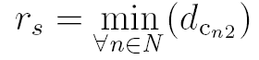
State-of-the-Art Protocols for Two-Hop
d_{cn1} is distance between BS and relay node,
d_{cn2} is distance between relay node and MS,
N is the no. of possible routes between MS and BS,
r_{s} is the selected route for the 2-hop transmission.
1. Shortest total distance (STD) selection scheme
2. Least longest hop (LLH) selection scheme
3. Shortest relaying hop distance (SRD) selection scheme

Slide 15
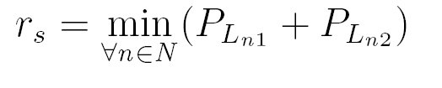
Realistic Version of State-of-the-Art Protocols
Considering a slow fading channel with a log normal shadowing
the relay selection scheme would be modified as:
1. Minimum total path loss (MTP) selection scheme
2. Least maximum path loss (LMP) selection scheme
3. Minimum relaying hop path loss (MRP) selection scheme

Slide 16
Cluster-based 2-Hop Design
The pairs located at diametrically opposite clusters communicate simultaneously.
Schematic Representation

Slide 17
Synchronized Reuse Technique
SH: End-to-end communication of 2 links in 1 TS
CBD-TH: End-to-end communication of 2 links (4 pairs) in 2 TSs
Same amount of radio resource as in single-hop communication

Slide 18
Communication Principle
End-to-end (BS to MS)
communication within
same TS
Same radio resource
reused across every
cell
Frequency reuse of
one
Notes:
There are 4 cases:
2 in Uplink and
2 in Downlink

Slide 19
Deterministic Cluster-based Design
r/2
Cell 0
Cell 0
r/2
r/2
r/2
Cell 1
Cell 1
r/2

Slide 20
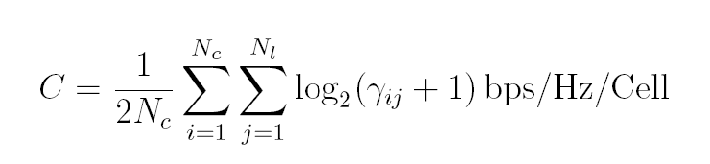
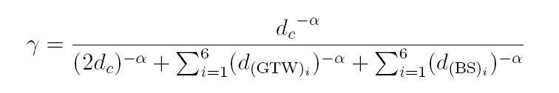
Interference Distance Calculation
Downlink, GTW to MS communication
Downlink, BS to GTW communication
The system capacity is calculated from the Shannon equation as:
C/I at receiver of any communicating pair is given by:

Slide 21
Simulation Parameters
1000 MS(s) distributed within 19 cells
All communication in any cell takes place between MS and BS
Maximum number of hops between source and destination is 2
Interference calculation – from its own cell and 1st tier of cells
System capacity is calculated and averaged over 7 cells
Wireless nodes located between Tx and Rx are selected as relays

Slide 22
Gateway Selection

Slide 23
Capacity Results - Downlink
Path-loss model remain the same for both single-hop and 2-hop model
2. Cluster-based design offers the maximum capacity for 2-hop cellular networks
3. σ = 4 dB.

Slide 24
Capacity Results - Uplink
Cluster-based design aims for resource reuse in every cell.
This results in the highest system capacity as compared to other benchmark techniques.

